Slide 1
Types of Machine Learning
Abhijit Ramesh Patil

Slide 2
What is linear regression?
Linear regression is the a model that estimates the relationship between one independent variable and one dependent variable
It has mainly two types :
-Simple linear regression
-Multiple linear regression
IT is used
To predict future economic conditions, trend.
To determine the relationship between two variables.
To understand how one variable changes when another changes.

Slide 3
What are different types of linear regression?
1) Simple linear regression :
One independent variable…One feature
One dependant variable…One label
2) Multiple linear regression :
More than one independent variable
More than one dependant variable

Slide 4
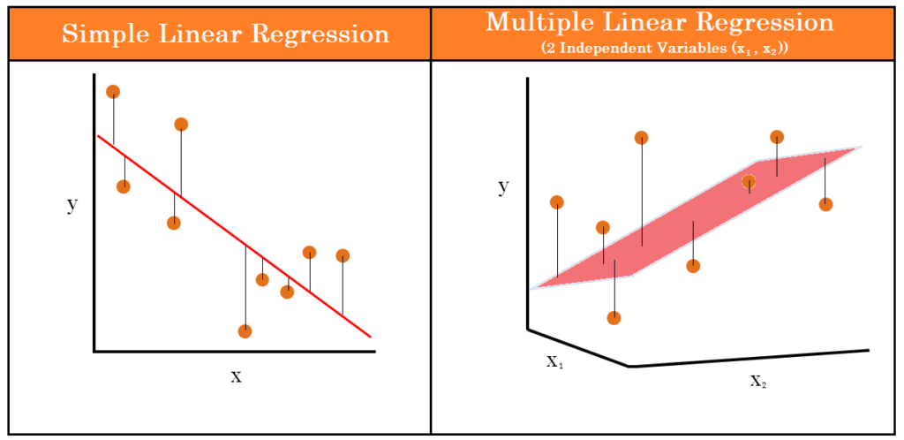

Slide 5
Equation of simple and multiple type linear regression?
1) Simple linear regression has only one independent variable (x) and one dependant variable (Y)
Y = mx + c
Where, m = slope, c = intercept
2) Multiple linear regression has more than one independent variable (x) and one dependent variable (Y).
Y = c + m₁x₁+m₂x₂+m₃x₃+……+m_{n}x_{n}
Where, m = slope, c = intercept
Slope is the rate of change if Y with respect to change in x.
Intercept is the constant value for the independent variable
x=0

Slide 6
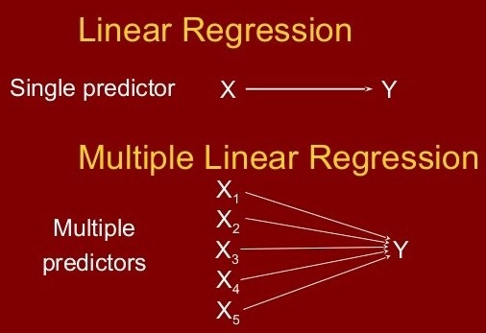

Slide 7
Example of simple and multiple linear regression
1) Example of simple linear regression :
Circumference of circle
Independent variable is radius.
Dependant variable is circumference of circle.
Medical research
Independent variable is dosage of certain drug.
Dependent variable is response of blood pressure.
Electricity bill
Independent variable is number of hours electricity used.
Dependent variable is Electricity charges.

Slide 8
2. Example of multiple linear regression :
Salary of employee
Independent variables are Qualification, Experience, Working hour
Dependent variable is Salary.
House price prediction
Independent variables are Area of house, Number of rooms, Distance from city.
Dependent variable is price of house.

